Slide 1
Islamic Values within the Context of Multicultural Citizenship in Madrasah Aliyah, Yogyakarta, Indonesia
SAMSURI RUSNALI WARIH & MUKHAMAD MURDIONO
Civic Education Department
Faculty of Social Sciences, Yogyakarta State University
E-mail: samsuri@uny.ac.id

Slide 2
Background
Tension between Islam and nationalism in Indonesia has arisen since early the 20th Century until 1950s and latest 1990s.
Indonesia, as biggest Muslim country around the world, has been challenged by nationalism issues such as separatism and decentralization, pluralism and conservatism on religion interrelationship, diversity and dialogue between inter and intra-religions, radicalism and extremism, and corruption.
Madrasah Aliyah (Islamic senior high school) in Indonesia is one of Islamic education institutions as a part of political accomodation for Indonesian Muslim to solve the tensions between Muslim and nationalists and secularists and non-Muslims society.

Slide 3
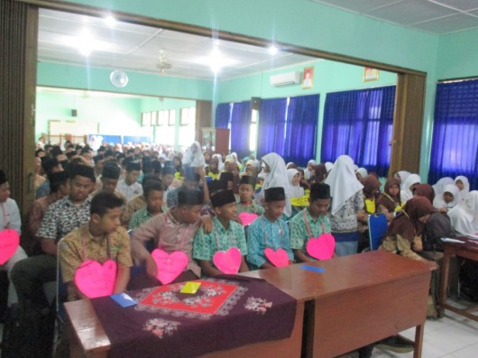
Background
Developing multicultural citizenship character, according to four consensi of nation and Islamic values and local wisdom in Madrasah Aliyah, in Yogyakarta, Indonesia, is a looking for solution that tensions.
Zakiyuddin Baidhawy (2007) introduced his studies on the importance of multicultural theology, especially in Indonesia. In his analysis, the majority of Muslim religious identity is found mainly in educational institutions sort of Madrasah Aliyah. It could be the best place to incultivate the harmony through religious education based multiculturalist theology.

Slide 4
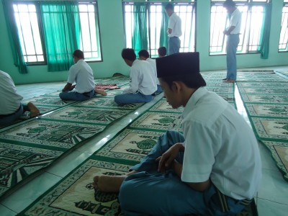
Background
In line with Lickona (1996) and the Character Education Partnership (2003), followed Pittman (2009), the character education in fostering multicultural citizenship should be done through a variety of activities. These activities included inter-group dialogue, service learning and workplace diversity training.
Following to Miller-Lane, Howard & Halagao (2007), civic education teacher has important role model as an ‘Islamic multiculturalist’ as well as ‘civic multiculturalist’ through some varieties of learning, such as social studies in which includes the topic of civic education in the United States.
Study of Samsuri and Marzuki (2014) found out that Madrasah Aliyah did not yet entirely fostering civic multicultural values based on the four consensi of Indonesian nationalism (Pancasila, Constitution of 1945, National Unity of Republic of Indonesia, and Bhinneka Tunggal Ika (Unity in Diversity) explicitly in school culture with civic multicultural program. It only taught by civics exclusively, as curricular program.
Madrasah Aliyah conducted two curriculum policies: Islamic teachings according to Ministry of Religions Affair, and public education following to Ministry of Education and Cultural.

Slide 5
Problems
How might Islamic values inspire teachers to educate the younger generation to become multicultural citizens?
How teachers in madrasah aliyah (Islamic senior high schools) use Islamic values, in the context of civic education, to cultivate a multicultural citizens?

Slide 6
Framework of Study
National diversity perspectives
‘Civic multicultural’
‘Islamic multicultural’
Citizenship Multicultural Programs in Madrasahs
National Consensi
Islamic teachings
Civic education teacher’s competencies
‘Local Wisdom’
values
Muslim diversity perspectives to other

Slide 7
Methods
The study conducted through focus group discussion (FGD) with the Civic Education teachers in three Madrasah Aliyahs on the multicultural citizenship character building based on nationality, religion, and values of local wisdom in school. Besides, the research data based upon the observation and documentation of citizenship character development implementation according to guide book that has been disseminated through the FGD.
Civic education teachers in three madrasahs have difference contexts.

Slide 8
Characteristics of Madrasahs
Characteristics Madrasah | School’s Profiles | Multicultural Contexts | Civic Education Teachers
MAN Yogyakarta I | Former of school for Islamic school for Law Judge candidacy, originally founded by Ministry of Religions Affair Urban Around the Public University, i.e. ‘secular campus’ such as UGM and UNY Implementing “Curriculum of 2013” | Plural Urban Competitiveness Boarding school for boy students (optional, limited) | Female teachers (2 persons) Master graduated Open Innovator
MAN Wonokromo Bantul | Former of school for Islamic teacher in elementary schools, originally founded by pesantren Rural ‘Pesantren’, Indonesian Islamic traditional education model, has been strong influencing to Madrasah Implementing “Curriculum of 2013” | Homogenous for Islamic thoughts Pesantren based culturally | Female teachers (3 persons) Open Innovator, one of three is a national champion for civic educator hold by Indonesian Court of Constitution (MK)
MAN Maguwoharjo Sleman | Former of school for Islamic teacher for blind students in elementary and junior/senior high schools, originally founded by Foundation of Islamic Community for Visual Disability (Yaketunis) Rural ‘Inclusion model’ has been vission to Madrasah Implementing “Curriculum of 2006” | Equality for all acceses for visual disabilty students Inclusion model | Female teachers (2 persons) Open Inclusive for visual disability students learning

Slide 9
Results
Culture of Madrasah Aliyah Program
Islamic values dominated all school activities.
Madrasah Aliyahs did not specifically define civic multicultural character for students through curricular programs such as Citizenship Education in schools. School as homogeneous community, it was never a problem.
There are not tensions between Islam and national identity for pupils. For example, Madrasah Aliyahs facilitated the students to engage in class flag-raising ceremony every monday; the opportunity to become team of flag raisers (Paskibra); follow competitions, the Quiz of "Four Pillars" by MPR, Citizenship Education Quiz Competition, Scouting, parliamentary debate, participate in Camping on inter-religious harmony by Ministry office; camping and coaching for the students with visual disabilities.

Slide 10
Results
Habituation Program
Islamic values what are developed in character building of multicultural citizenship in madrasahs, namely piety, patriotism, obedience, honesty, respect, consultation, mutual help, cleanliness, hard work, patience, discipline, justice, sincere charity.
National values developed in character building of multicultural citizenship at the school are patriotism, nationalism, willing to sacrifice, willing to accept differences, tolerance, unity, justice, deliberation, hard work, mutual help.
Meanwhile, the values of local wisdom developed in the character building of multicultural citizenship at the school are the value of patience; courtesy; tepa salira (tolerance); nerima ing pandum; aja dumeh; aja adigang, adigung, adiguna; sepi ing pamrih rame ing gawe.

Slide 11
Results
Habituation Program
Multicultural values are developed and imparted to students through Civics (PPKn), included: mutual help, unity, cooperation, empathy, national consciousness, honesty, mutual cooperation, tolerance, peace, consensus, patience, fairness, discipline, respect, love homeland, obedience, cleanliness, and hard work values.
In another part, the efforts of teachers in developing the attitudes of tolerance, respect for diversity and care about the inevitability of the plurality done through:
acceptance of differences
Socialization with national songs
A willingness to be criticized by students
The formation since the beginning of school entry (MOS)
Modeling
Awareness of the differences with the student record
Election student union members.

Slide 12
Results
Habituation Program
Islamic values what are developed in character building of multicultural citizenship in madrasahs, namely piety, patriotism, obedience, honesty, respect, consultation, mutual help, cleanliness, hard work, patience, discipline, justice, and sincere charity.
National values developed in character building of multicultural citizenship at the school are patriotism, nationalism, willing to sacrifice, willing to accept differences, tolerance, unity, justice, deliberation, hard work, mutual help.
Meanwhile, the values of local wisdom developed in the character building of multicultural citizenship at the school are the value of patience; courtesy; tepa salira (tolerance); nerima ing pandum; aja dumeh; aja adigang, adigung, adiguna; sepi ing pamrih rame ing gawe.

Slide 13
Disscusion
Each Madrasah Aliyah seems that multicultural citizenship character-based pillars of nationality, religious values and local wisdom, has been implemented adequately, as has been initiated in the education policy of the character as created by the Ministry of Education and Culture (2010). Nevertheless, among the three Madrasah Aliyahs there are differences in responding to issues of cultural diversity and traditions around the school, as well as the background of religious belief and understanding of where students live with family.
In addition, the background of the establishment of each Madrasah Aliyah has pattern to formulate multicultural character development as envisaged in their vision, mission and objectives. It is also supported by the historical development of the institution status and institutionalization of school culture.

Slide 14
Disscusion
Each school aware that their background has commonality as muslim, and all students are muslim. But, their mazhab is possible to be plural/different.
One of school (MAN 1 Yogyakarta) used different students background to carry out the culture product for Social Studies Laboratory. Laboratory collected student’s contribution which describes multicultural of his/her community. Laboratory introduced the multicultural artefacts for students, and taught how his/her communicate with other.

Slide 15
Disscussion
For example:
MAN Yogyakarta I, as a continuation school of PHIN, inherites the tradition of urban students from vary regions, has very strong contiguity between the domestic public schools and universities around Gadjah Mada University and the State University of Yogyakarta.
MAN Maguwoharjo Wonokromo Bantul and Sleman have a background of a former school teacher of Religious Education in rural areas. They carry out a number of implications.
MAN Wonokromo Bantul closed and thick with Islamic tradition helped influence upon each contact and communication between students and their environment.
Similarly, MAN Maguwoharjo Sleman which stems from the conversion of PGA for visual disability (PGA LB "A“), its development focused aspects of inclusion as a vision. Inclusion intended as a way to understand and engage school and community elements to the provision of equal opportunities for students with special needs (the blind) to be studied together with sighted students.

Slide 16
Terima Kasih
Thank You

